Slide 1
Group Members
VS
AV
AJ
AT
Vibhu Kumar Singh
Anamaya Vyas
Aaron Niju John
Avnish Tiwari
19BCE0215
19BCE0568
19BCE0616
19BCE0634
Operating System Project
Operating System Project

Slide 2


VIT Vellore • Oct. 28, 2020
Building a
Basic Kernel
Operating System Project

Slide 3

DISCUSSION OUTLINE
Report Coverage
VIT Vellore • Oct. 28, 2020
Introduction
Problem Definition
Literature Review
Existing Approach
Proposed Approach
Implementation
Conclusion
Future Works
References

Slide 4

Introduction
Part 01

Slide 5

What is a Kernel?

Slide 6

Kernel: The Heart of the OS
The kernel is a computer program at the core of a computer's operating system with complete control over everything in the system.
It is an integral part of any operating system and serves a role similar to heart in a body.

Slide 7

What are the different kernel architecture designs present?

Slide 8
There are different kernel architecture designs:
Monolithic Kernel
It is one of the types of kernel where all operating system services operate in kernel space.
Micro Kernel
It is a kernel type which has a minimalist approach. It has virtual memory and thread scheduling. It is more stable with less services in kernel space.
Hybrid Kernel
It is the combination of both monolithic kernel and mircrokernel.
Exo Kernel
It is the type of kernel which follows end-to-end principle. It has fewest hardware abstractions as possible
Nano Kernel
It is the type of kernel that offers hardware abstraction but without system services.

Slide 9

The linux kernel’s source code when deemed to be suitable for production environments, had around 176 thousand lines of source code and currently contains about 27.8 million lines of code.
While we are unable to build a kernel at such a scale with our limited knowledge on the development of kernels, we wanted to try to build a basic kernel with basic functions to understand the complex and tedious process behind kernel development.
Problem Definition

Slide 10

Literature Review
Part 03

Slide 11
Problem Statement
#1
This research paper gives us insight into the world of Linux kernel development and gives us an overall glimpse of the process behind Linux kernel development from the social aspects to building the kernel to repeated testing to finally releasing the code.
Linux Kernel Development – Ian McDonnald – Fifth New Zealand Computer Science Research Student Conference, 2007
Advantages
This research paper gives a complete overview on the various steps involved in the Linux kernel development and gives new kernel developers tips, ticks and caveats as well as commands and tools that can prove to be extremely useful in the development process.
Limitations
While this research paper gives a complete overview on the various steps of Linux kernel development, it doesn’t give an in-depth analysis and explanation of each step.
Comstech • Oct. 15, 2020

Slide 12
#2
Problem Statement
The paper states that the whole system would crash as well as the possibility of some applications making use of some mechanisms in the operating system to capture the CPU time to execute all kinds of malicious or destructive operations, such as tampering data, monopolizing resources, even causing the system crash or user data missing.
Research of an architecture of operating system kernel based on modularity concept - Hongbiao Jiang, Wanlin Gao, Manwei Wang, Simon See, Ying Yang, Wei Liu, Jin Wang
Advantages
This architecture intimately concerns with safety and protection of user data. The communication interface between modules is simple and unified because it is implemented by timer interrupt and addresses structure.
Limitations
The main potential problem of the proposed architecture is the executing efficiency of the system because of the extra communication overhead of three kernel modules.
Comstech • Oct. 15, 2020

Slide 13
Problem Statement
#3
While designing a kernel for embedded systems we face difficulties to predict real time scheduling such as radio transmitter device controller and high level abstraction interface such as web browser.
Composition Kernel: A Software Solution for Constructing
a Multi-OS Embedded System
Yuki Kinebuchi, Kazuo Makijima, Takushi Morita, Alexandre Courbot,
and Tatsuo Nakajima
Solutions
The approach removes the strong dependencies between OS kernels and instead, let them depend on the underlying thin abstraction layer which requires minimal modification to the OS kernels running on top of it.
Limitations
The evaluation shows that the approach requires significantly small modifications compared with works it is inspired from. At the same time it introduces negligible overhead to the real-time responsiveness of the guest RTOS.
Comstech • Oct. 15, 2020

Slide 14
#4
Problem Statement
The usage of operating systems in data mining is less and not very effective
Research on Kernel Function of Support Vector Machine
Lijuan Liu,Bo Shen, Xing Wang
Solutions
The study of kernel function is an important data mining research content, so choosing appropriate kernel function and parameters can give full play to the performance of SVM and even has remarkable significance in promoting the popularization and application of data mining.
Limitations
Realizing data mapping efficiently and reliably in the environment of big data.
Comstech • Oct. 15, 2020

Slide 15
Problem Statement
#5
To implement a new booting process and its components in regional language as well as all the applications in regional language, entire operating systems and its process (different messages) in regional language.
Bhatt Milan, Dolia Prashant, “Proposed Booting screen and Architecture in regional language for Linux based mobile devices”, IJCA, NCETICT – 2013.
Advantages
We found there are no regional language characters to display on the booting screen in Linux based handheld devices . Facing the challenge in solving the unsolved problem, the researcher focused on introducing a new proposed booting process and its component and its process (different messages) given in regional language.
Limitations
The researcher constrained the research only to the mobile phones whereas a similar problem is there for the laptops. Also as we see in the paper only a particular regional language is implemented whereas he could’ve easily given a set of options for choosing different languages.
Comstech • Oct. 15, 2020

Slide 16
#6
Problem Statement
To look at two different approaches used to provide embedded system support for virtualization and virtual machine monitors for consumer electronics and mobile devices.
Francois Armand and Michel Gien, “A Practical Look at Micro-Kernels and Virtual Machine Monitors”, IEEE Computer Society, 2008.
Advantages
The researcher presented two approaches, such as micro-kernel and hypervisor. Here, the virtualization was an extension to OS in micro-kernel whereby, extension to the hardware in hypervisor. At the end, the hypervisor approach used embedded systems as an alternative for complete OS as guest than the microkernel functionality extension.
Limitations
After reviewing the paper we saw hypervisor and microkernel approaches seem to address similar concerns. The area of the research was not that extensive that it should be. Limited information about how the kernel and hypervisor function.
Comstech • Oct. 15, 2020

Slide 17
Problem Statement
#7
This paper presents an architectural overview of the QNX operating system.
D. Hildebrand, “An architectural overview of QNX.” In Proc. of the USENIX Workshop on Microkernels and other Kernel Architectures, Seattle, WA, USA, pp. 113–126, Apr. 1992.
Advantages
It explains the whole working of the kernel. Also it compares the monolithic and microkernels and it is clear that a microkernel system can both outperform and provide greater functionality than a monolithic kernel system while still providing a compatible API for application programs.
Limitations
It still does not approach that of a procedure call, encouraging the construction of monolithic, non-extensible systems. For example, the L3 microkernel, even with its aggressive design, has a protected procedure call implementation with overhead of nearly 100 procedure call times.
Comstech • Oct. 15, 2020

Slide 18
#8
Problem Statement
Tailoring a Linux kernel to one’s needs.
K. Bak and K. Ali. Improving usability of the Linux kernel configuration tools.
Advantages
Advantages include: free navigation, few categories of features, understandable (and helpful) description text, useful search tools, automatic hardware detection and they provide that.
Limitations
Although sophisticated configurator support exists, configuring systems according to a variability model still remains a difficult process. Users often cannot complete a
configuration without external help and configuration errors can cause disastrous results.
Comstech • Oct. 15, 2020

Slide 19

Existing Approach
Part 04

Slide 21

Proposed Approach
Part 05

Slide 22

Implementation
Part 06

Slide 23
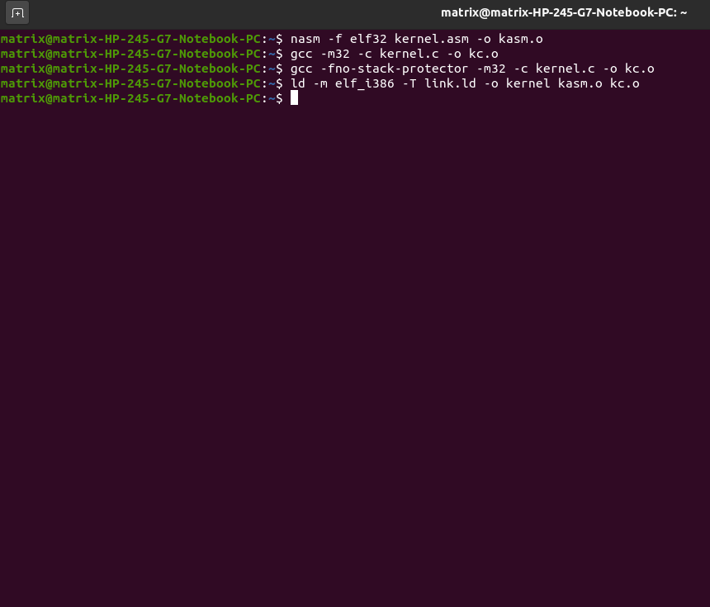

Slide 24
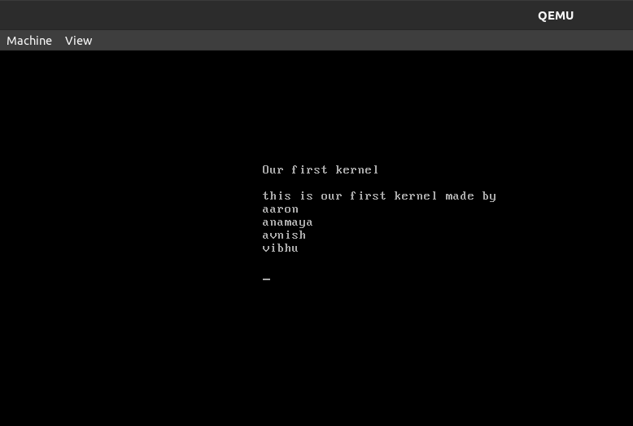

Slide 25

Conclusion
Part 07
With this project, we have successfully completed the development and implementation of a basic kernel which can be loaded using a GRUB bootloader on an x86 system and also include a keyboard driver that can print the characters a-z and numbers 0-9 on the screen.

Slide 26

Future Works
While this kernel may not have much practical use or solve any real-world problem and was mainly designed to serve as a technology demonstrator, this kernel can serve as the foundation for building a more advanced kernel with more complex operations and the experience and knowledge gained during this process will help us in achieving just that.
Part 08

Slide 27
D. Hildebrand, “An architectural overview of QNX.” In Proc. of the USENIX Workshop on Microkernels and other Kernel Architectures, Seattle, WA, USA, pp. 113–126, Apr. 1992.
Linux Kernel Development – Ian McDonnald – Fifth New Zealand Computer Science Research Student Conference, 2007.
Bhatt Milan, Dolia Prashant, “Proposed Booting screen and Architecture in regional language for Linux based mobile devices”, IJCA, NCETICT – 2013.
Francois Armand and Michel Gien, “A Practical Look at Micro-Kernels and Virtual Machine Monitors”, IEEE Computer Society, 2008.
Linux Kernel Development – Ian McDonnald – Fifth New Zealand Computer Science Research Student Conference, 2007.
Yuki Kinebuchi, Hitoshi Mitake, Yohei Yasukawa, Takushi Morita, Alexandre Courbot, and Tatsuo Nakajima. A Study on Real-time Responsiveness on Virtualization based Multi-OS Embedded Systems. In C´esar Benavente-Peces and Joaquim Filipe, editors, Proceedings of the 1st International Conference on Pervasive and Embedded Computing and Communication Systems (PECCS 2011). SciTePress, 2011.
T. Gartner, P. A. Flach, A. Kowalczyk, and A. J. Smola. Multi-instance kernels. In C. Sammut and A. Hoffmann, editors, Proceedings of the 19th Interna tional Conference on Machine Learning, pages 179-186. Morgan Kaufmann, June 2002 .
Hiromasa Shimada, Yuki Kinebuchi, Tsung-Han Lin, Alexandre Courbot, and Tatsuo Nakajima. Design issues in composition kernels for highly functional embedded systems. In SAC ’11: Proceedings of the 2011 ACM Symposium on Applied Computing. ACM Request Permissions, March 2011
C. Watkins. Kernels from matching operations . Technical report, Department of Computer Science, Royal Holloway, University of London, 1999 .
S. Vishwanathan and A. Smola. Fast kernels for string and tree matching . In S . Becker, S. Thrun, and K. Obermayer, editors, Advances in Neural Information Processing Systems, volume 15 . MIT Press, 2003 .
References
Part 09

Slide 28


Slide 29

Comstech • Oct. 15, 2020
Human Communication
Presentations are communication tools that can be used as lectures.
A WORLD BEFORE THE INTERNET

Slide 30


Connections in the Internet Era
Presentations are communication tools that can be used as lectures, reports, and more.
Comstech • Oct. 15, 2020

Slide 31



YOUR COMPUTER
Presentations are communication tools.
How does the Internet Work
INTERNET
Presentations are communication tools.
ANOTHER COMPUTER
Presentations are communication tools.
Comstech • Oct. 15, 2020

Slide 32
A GLOBAL VILLAGE
How does it Connect Us
Comstech • Oct. 15, 2020
Presentations are tools that can be used as demonstrations, lectures, speeches, reports, and more.

Slide 33


Presentations are tools that can be used as lectures.
LIFE BEFORE THE INTERNET
LIFE WITH THE INTERNET
Presentations are tools that can be used as lectures.

Slide 34
NPL NETWORK & ARPANET
Presentations are communication tools that can be used as lectures.
Timeline
TCP/IP
Presentations are communication tools that can be used as lectures.
FROM THEN TO NOW
Comstech • Oct. 15, 2020
CERN & EUROPEAN INTERNET
Presentations are communication tools that can be used as lectures.

Slide 35
EDUCATION
Presentations are tools that can be used as lectures.
What the Internet Provides
ENTERTAINMENT
Comstech • Oct. 15, 2020
Presentations are tools that can be used as lectures.
BUSINESS
Presentations are tools that can be used as lectures.

Slide 36
Usage Milestones
EMAIL & USENET
HTTP & WWW
Presentations are tools that can be used as lectures.
Presentations are tools that can be used as lectures.
SEARCH
ENGINES
MOBILE COMPUTING
Presentations are tools that can be used as lectures.
Presentations are tools that can be used as lectures.
Comstech • Oct. 15, 2020

Slide 37



Google
Most Used Websites
Youtube
Comstech • Oct. 15, 2020
BASED ON ALEXA RANKINGS
Facebook

Slide 38
55%
AS OF 2018:
WORLD POPULATION WITH
NET ACCESS
Presentations are communication tools that can be used as lectures.

Slide 39

30% of users
70% of users
IN THE DEVELOPING WORLD
IN THE DEVELOPED WORLD
Comstech • Oct. 15, 2020

Slide 40
ACCORDING TO REGION
40
Internet Users as of 2020
30
Comstech • Oct. 15, 2020
20
10
Presentations are tools that can be used as demonstrations, lectures, speeches, reports, and more.
0
Item 1
Item 2
Item 3
Item 4
Item 5

Slide 41

DIRECT BENEFITS
SECONDARY EFFECTS
Presentations are tools that can be used as lectures.
Presentations are tools that can be used as lectures.
Comstech • Oct. 15, 2020
Positive Effects of the Internet

Slide 42
ACCORDING TO REGION
Presentations are tools that can be used as lectures.
Positive Effects of the Internet
DIGITAL DIVIDE
Presentations are tools that can be used as lectures.
ONLINE BULLYING
Presentations are tools that can be used as lectures.
Comstech • Oct. 15, 2020

Slide 43
EDUCATING USERS
Presentations are tools that can be
used as lectures.
BEING CRITICAL THINKERS
Presentations are tools that can be
used as lectures.
PROTECTING ONLINE PRIVACY
How to Combat These Problems
Presentations are tools that can be
used as lectures.

Slide 44
The Ripple Effect of the Internet
EFFECTS ON
SOCIETY
EFFECTS ON THE COMMUNITY
Comstech • Oct. 15, 2020
EFFECTS ON A PERSON
Presentations are tools that can be used as lectures.
Presentations are tools that can be used as lectures.
Presentations are tools that can be used as lectures.

Slide 45



WHAT THE FUTURE BRINGS
Presentations are tools that can be used as lectures.
Comstech • Oct. 15, 2020

Slide 46

The Presenters
Comstech • Oct. 15, 2020
GLENN ERDHART
Team Leader
FROM GROUP 5

Slide 47

The Presenters
Comstech • Oct. 15, 2020
JAMES PASCARELLA
Research Lead
FROM GROUP 5

Slide 48

The Presenters
Comstech • Oct. 15, 2020
KARTIK STEVENSON
Spokesperson
FROM GROUP 5

Slide 49
Quarkgrove College
MAILING ADDRESS
123 Anywhere St., Any City, State, Country 12345
Comstech • Oct. 15, 2020
PHONE NUMBER
(123) 456 7890
PRESENTED TO THE COMPUTER & TECHNOLOGY DEPARTMENT
E-MAIL ADDRESS
hello@reallygreatsite.com

Slide 50
Other Resources
THE INTERNET IN A NUTSHELL
Comstech • Oct. 15, 2020
www.reallygreatsite.com
ACROSS THE INFORMATION SUPERHIGHWAY
www.reallygreatsite.com
ONLINE CONNECTIVITY
www.reallygreatsite.com

Slide 51
SOMETHING TO THINK ABOUT
Comstech • Oct. 15, 2020
The internet is not a luxury, it is a necessity.
BARACK OBAMA

Slide 52







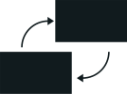
















Free Resources
Use these free, recolourable icons and illustrations in your Canva design.

